Slide 1
WCF Security
OWASP Los Angeles
Culver City, CA Nov 2012
Securing your Service Oriented Architecture
Presented at OWASP Los Angeles Chapter Meeting – 11/28/2012
Adnan Masood adnan.masood@owasp.org
http://blog.adnanmasood.com
@adnanmasood

Slide 2
about the speaker
Adnan Masood works as a system architect / technical lead for Green dot Corporation where he develops SOA based middle-tier architectures, distributed systems, and web-applications using Microsoft technologies. He is a Microsoft Certified Trainer holding several technical certifications, including MCPD (Enterprise Developer), MCSD .NET, and SCJP-II. Adnan is attributed and published in print media and on the Web; he also teaches Windows Communication Foundation (WCF) courses at the University of California at San Diego and regularly presents at local code camps and user groups. He is actively involved in the .NET community as cofounder and president of the of San Gabriel Valley .NET Developers group.
Adnan holds a Master’s degree in Computer Science; he is currently a doctoral student working towards PhD in Machine Learning; specifically discovering interestingness measures in outliers using Bayesian Belief Networks. He also holds systems architecture certification from MIT and SOA Smarts certification from Carnegie Melon University.

Slide 3
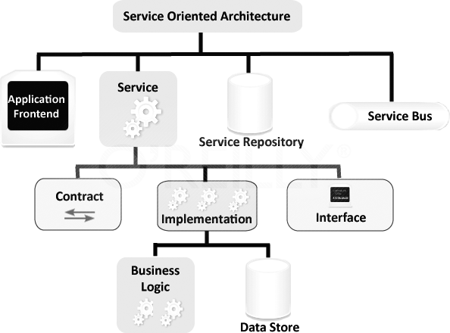
Service Oriented Architecture
A service-oriented architecture (SOA) is a set of principles and methodologies for designing and developing software in the form of interoperable services.
Notes:
SOA establishes an architectural model that aims to enhance the efficiency, agility, and productivity of an enterprise by positioning services as the primary means through which solution logic is represented in support of the realization of the strategic goals associated with service-oriented computing.
On a fundamental basis, the service-oriented computing platform revolves around the service-orientation design paradigm and its relationship with service-oriented architecture. In fact, the term "service-oriented architecture" and its associated acronym have been used so broadly by the media and within vendor marketing literature that it has almost become synonymous with service-oriented computing itself. It is therefore very important to make a clear distinction between what SOA actually is and how it relates to other service-oriented computing elements.
As a form of technology architecture, an SOA implementation can consist of a combination of technologies, products, APIs, supporting infrastructure extensions, and various other parts. The actual face of a deployed service-oriented architecture is unique within each enterprise; however it is typified by the introduction of new technologies and platforms that specifically support the creation, execution, and evolution of service-oriented solutions. As a result, building a technology architecture around the service-oriented architectural model establishes an environment suitable for solution logic that has been designed in compliance with service-orientation design principles.

Slide 4
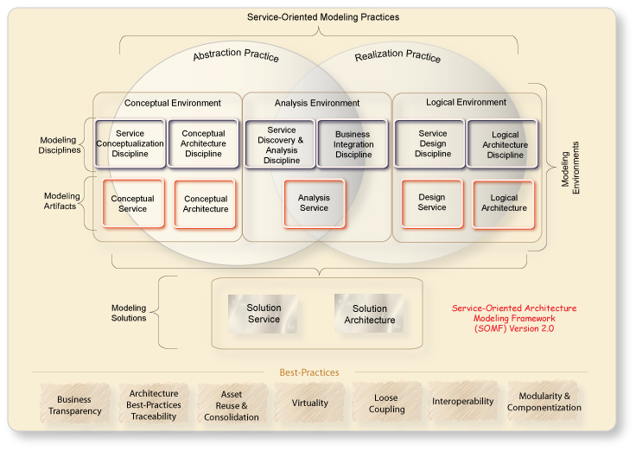

Slide 5
What is an SOA Service?
A SOA service is composed of three parts:
A service class that implements the service to be provided
A host environment to host the service
One or more endpoints to which clients will connect
All communication with a service happens through the endpoints. Each endpoint specifies a contract (which we will discuss in greater detail later in this chapter) that defines which methods of the service class will be accessible to the client through that specific endpoint.
Because the endpoints have their own contracts, they may expose different (and perhaps overlapping) sets of methods. Each endpoint also defines a binding that specifies how a client will communicate with the service and the address where the endpoint is hosted.

Slide 6
Tenants of SOA
Boundaries are explicit.
Services are autonomous.
Schemas and contracts are shared, but not classes.
Compatibility is based on policy.

Slide 7
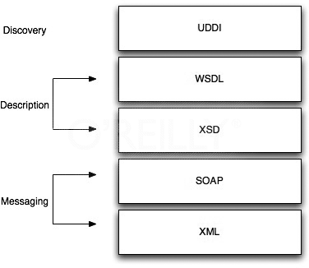
Web Services Protocol Stack
http://msdn.microsoft.com/en-us/library/orm-9780596527563-01-10.aspx

Slide 8
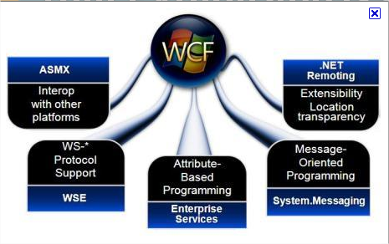
SOA using WCF
Interoperability across platforms
Unification of existing technologies
Enabling service-oriented development

Slide 9
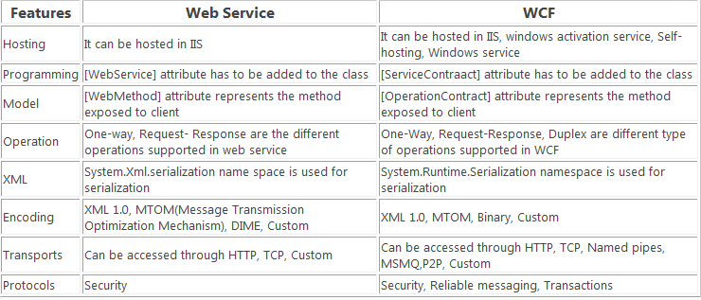

Slide 10
What is WCF?
Microsoft .Net framework API that unifies many existing standards: WS-Addressing, WS-ReliableMessaging, WS-Security etc.
Supports a number of different protocols
Compatible with non-Microsoft web services and clients
Service Oriented Architecture
A WCF Service is composed of Service class, hosting environment and one or more Endpoints
Notes:
SOAP message uses XML format, platform and language independent
Protocols: tcp, named pipes, http, msmq…
SOA: Loosely coupled architecture where clients can consume multiple services and services can be consumed by multiple clients.
From Wikipedia: A WCF Service is composed of three parts — a Service class that implements the service to be provided, a host environment to host the service, and one or more endpoints to which clients will connect. All communications with the WCF service happens via the endpoints. The endpoints specify a Contract that defines which methods of the Service class will be accessible via the endpoint; each endpoint may expose a different set of methods. The endpoints also define a binding that specifies how a client will communicate with the service and the address where the endpoint is hosted.

Slide 11
Endpoint = ABC
Address (where is service) http://localhost:8000/servicename
Binding (how do I talk to it) WSHttpBinding
Contract (what can it do) [ServiceContract] [DataContract] [OperationContract] [FaultContract]
Notes:
Building a WCF service means writing and configuring the ABCs. Define a contract, implement it on a service, choose binding, and deploy an endpoint for the contract by binding it to a network address.
Address: A URI, typically including a port number, can be suffixed with servicename. In the wsdl.service section, links wsdl:binding to a concrete service endpoint address.
Binding: In the wsdl:binding section, binds a wsdl:portType contract description to a concrete transport, an envelope format and associate policies Types: BasicHttp, NetTcp, NetPeerTcp, NetNamedPipe, WSHttp, WSFederatedHttp, WSDualHttp, NetMsmq Each has its subset of allowable security modes(None, Transport, Message, Mixed, Both)
Contract: In the wsdl:portType, wsdl:message and wsdl:type sections describes types, messages message exchange patterns and operations. Service (Contains operations) Data (Type… Person for example with string Name, int Age) Operation (Method) Fault (exceptions)

Slide 12
WCF Authentication (who)
Who are you (client, server)?
Authentication Types: None, Windows authentication, Username and Password, X.509 Certificate, Issued Token, Custom
For Certificate, the local Cert Store is checked.
IIdentity interface.
Notes:
Must xpecify the Client credential Type as X.509 Certificate for message security
An identity object is created to represent the user certificate.
Use ChainTrust to make sure opposing party’s CA certificate is in Trusted Root Certification Authorities certificate store or PeerTrust to check for the opposing certificates in trusted people certificates
Certificate: A digitally signed statement that contains information about an entity and the entity's public key, thus binding these two pieces of information together. A certificate is issued by a trusted organization (or entity), called a certificate authority, after the authority has verified that the entity is who it says it is. Certificates can contain different types of data. For example, an X.509 certificate includes the format of the certificate, the serial number of the certificate, the algorithm used to sign the certificate, the name of the CA that issued the certificate, the name and public key of the entity requesting the certificate, and the CA's signature.
certificate store: Typically, a permanent storage where certificates, certificate revocation lists (CRLs), and certificate trust lists (CTLs) are stored. It is possible, however, to create and open a certificate store solely in memory when working with certificates that do not need to be put in permanent storage.
server certificate: Refers to a certificate used for server authentication, such as authenticating a Web server to a Web browser. When a Web browser client attempts to access a secured Web server, the server sends its certificate to the browser to allow it to verify the server's identity.
client certificate: Refers to a certificate used for client authentication, such as authenticating a Web browser on a Web server. When a Web browser client attempts to access a secured Web server, the client sends its certificate to the server to allow it to verify the client's identity.
certificate authority (CA) certificate: Identifies the CA that issues server and client authentication certificates to the servers and clients that request these certificates. Because it contains a public key used in digital signatures, it is also referred to as a signature certificate. If the CA is a root authority, the CA certificate may be referred to as a root certificate. Also sometimes known as a site certificate.

Slide 13
WCF Authorization (what)
What does the client have access to do?
Windows Groups (default)
ASP.Net Membership provider (SQL Server)
WCF provides IPrincipal interface and some implementing classes.
Notes:
What operations does the client have access to? Usually based on roles, which may be specified by Windows groups, or Asp.net membership provider and its roles.
a principal object that represents the security context under which code is running
IPrincipal:
Bool IsInRole(role)
IIdentity Identity

Slide 14
WCF Transfer Security (how)
How are messages secured while in transit?
Transfer Security types: None, Transport, Message, Mixed, Both
Message: end to end, slower, more complicated
Transport: fast, hop-to-hop
Notes:
WCF supports Transport and/or Message security. Transport specifies security options specific to the binding type (net.tcp, ws-http, named pipes, etc). If you are using ws-http type, SSL/TLS is the transport security. Message Security involves encrypting the message, and in the non-proprietary Internet and B2B scenarios, is the type recommended due to it’s end-to-end nature.
Disadvantages of Message-Level Security
Performance
Cannot use message streaming.
Requires implementation of XML-level security mechanisms and support for WS-Security specification. This might affect the interoperability.
Pros and Cons of Transport-Level Security
Does not require that the communicating parties understand XML-level security concepts. This can improve the interoperability, for example, when HTTPS is used to secure the communication.
Generally improved performance, Hardware accelerators are available, Streaming is possible.
Hop-to-hop only.
Limited and inextensible set of credentials.
Transport-dependent.

Slide 15
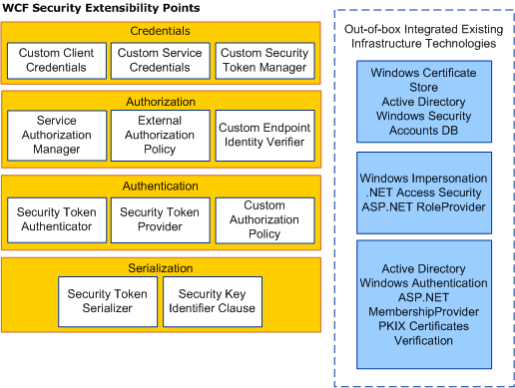
WCF provides three important security features
Confidentiality
Integrity
Authentication
Security is on by default in almost all bindings
You configure transport vs. Message using the security mode
You configure Authentication via the client credential type
WCF Provides numerous authorization options
Impersonation
Role based access control
Service authorization behavior

Slide 16
The CIA of Security
Is Security Important?
Do you have resources that have value to an adversary?
If yes, then you must expect to be attacked.
WCF provides basic protections that you need: CIA.
Confidentiality | Integrity | Authentication
Encrypting Messages Mitigates eavesdropping attacks. | Signing messages mitigates tampering and replay attacks. | Proof of identity mitigates spoofing and impersonation attacks.

Slide 17
Decisions Decisions!
The protection level required by your services
Should the data be signed, encrypted or both?
Transport vs. message security on bindings
Can also use a hybrid of the two
Authentication, or “who are you?”
You choose the type of credentials you want the client to use and WCF will pick an appropriate authentication protocol
Authorization or “what are you allowed to do?”
Impersonate the caller, letting someone else handle authz
Provide your own authorization management

Slide 18
Declaring the required protection level
The developer of a service doesn’t ultimately control how it’s exposed
So what if the host application exposes unsecure endpoints
Hence, developers can set the required protection level on contracts
The host will fail if the required protection level isn’t met by an endpoint
Setting Protection Level at Different Scopes
On a particular message
On individual operations and fault contracts
On a service contract

Slide 19
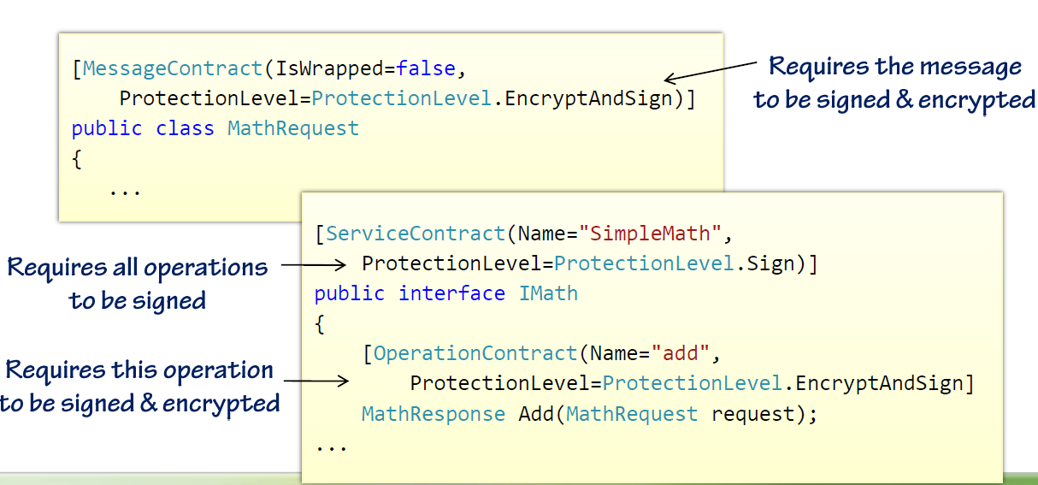
Protection Level
Simply use the protection level property on the appropriate attribute
Possible Values: None, Sign, and EncryptAndSign

Slide 20
Configuring security in WCF Bindings
Security Mode | Client Credential Type
Transport Message Mixed | Username Certificate Windows IssuedToken
These two choices determine how security protocols will be implemented.

Slide 21
Configuring Binding Security Settings
Bindings | Configuration
Windows Integrated Authentication | <wsHttpBinding> <binding name="MyTransportSecurityBinding"> <security mode="Transport"> <transport clientCredentialType="Windows"/> </security> </binding> </wsHttpBinding>
Service Supplies X.509 cert; client supplies username + password | <wsHttpBinding> <binding name="MyMessageSecurityBinding"> <security mode="Message"> <message clientCredentialType="UserName"/> </security> </binding> </wsHttpBinding>
Service runs SSL client supplies SAML token | <wsHttpBinding> <binding name="MyMixedSecurityBinding"> <security mode="TransportWithMessageCredential"> <message clientCredentialType="IssuedToken"/> </security> </binding> </wsHttpBinding>

Slide 22
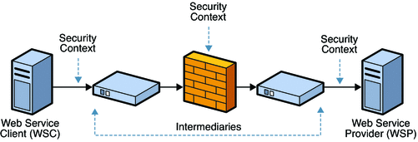
Transport Security
Each Transport typically has a built in security layer that you can use
HTTP using SSL
TCP/NP using Kerberos
MSMQ using certificates
Provides point to point security between nodes

Slide 23
Transport Security Trade-Offs
Benefits
Mature and well understood Security Model
Better Performance
Drawbacks
Constrains the type of client credentials
You get point to point authentication, not end to end authentication

Slide 24
Message Security
Message Security pushes authentication down into SOAP headers
Provides same security features as transport security
But in transport-neutral way (pushes security into SOAP messages)
Provides an end to end security solution across all nodes

Slide 25
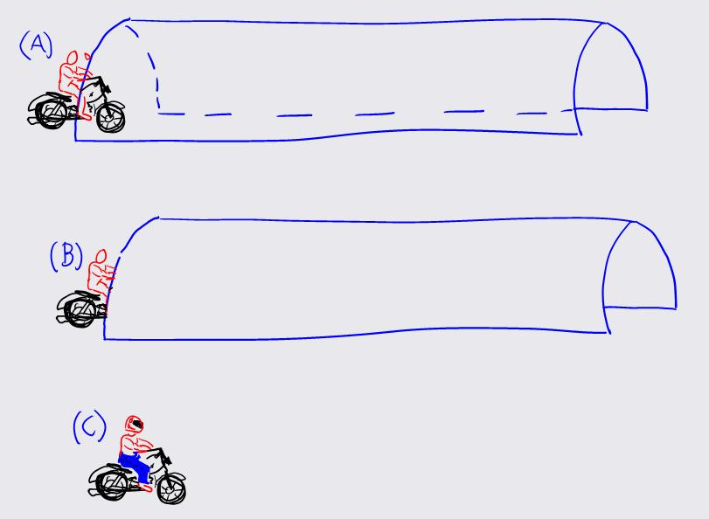
Interesting Analogy ☺
http://blogs.msdn.com/b/vbertocci/archive/2005/04/25/end-to-end-security-or-why-you-shouldn-t-drive-your-motorcycle-naked.aspx

Slide 26
Message Security Tradeoffs
Benefits
Supports a wide variety of crednentials
Largely independent of transport
Supports end to end authentication
Multiple WCF extensibility hooks
Drawbacks
Newer isn’t always better for security
WS-* isn’t as broadly adopted as SSL
Perf can be significantly worse

Slide 27
Mixed Mode
TransportwithMessageCredential
Speed and maturity of transport security
Flexibility of client credentail types embdeed in message
Transport security typically supplied by SSL
Authenticates service to client via service’s certificate
Sign and encrypt payload
WS-Security header holds client credential
Opens Up many options for credential format

Slide 28
Authentication in standard bindings
Binding Name | Transport | Message | Default Client Credential
BasicHttpBinding | Supported | Supported | None
WSHttpBinding | Supported | Default | Windows
WSDualHttpBinding | Supported | Default | Windows
NetTcpBinding | Default | Supported | Windows
NetNamedPipesBinding | Default | Supported
NetMsmqBinding | Default | Supported

Slide 29
Security Call Context
Every secure WCF operation has a ServiceSecurityContext object
ServiceSecurityContext.Current
OperationContext.ServiceSecurityContext
The context object provides you with information about the caller
Use PrimaryIdentity or WindowsIdentity to access the IIdentity object
IsAnonymous will tell you if it was an anonymous call

Slide 30
Authorization Options
Role-based Access Control
Windows groups a simple option (use Iprincipal)
Use an ASP.NET role provider
PrincipalPermission works reasonably well
ServiceAuthorizationBehavior
Decision based on SOAP action & client identity
Fires earlier than PrincipalPermission
Keeps Authz logic out of service implementation
Impersonation
Only an option with windows crednetials
User WindowsIdentity.Impersonate or [OperationBehavior]

Slide 31
Impersonation
Impersonation is a Windows Feature
Must be using Windows authentication for this to work
Easy to get this working for local resources
Trickier for remote resources (requires delegation)
Temporarily take on the client identity
You’re passing the authorization problem to a system behind you
Great when you’re accessing existing secure resources
Can eliminate the need for you to implement authz in your app

Slide 32
Summary & Conclusion

Slide 33
WCF provides three important security features
Confidentiality
Integrity
Authentication
Security is on by default in almost all bindings
You configure transport vs. message using the security mode
You configure authentication via the client credential type
WCF provides numerous authorization options
Impersonation
Role-based access control via groups, roles or claims
Service authorization behavior

Slide 34
References
Security in Windows Communication Foundation http://msdn.microsoft.com/en-us/magazine/cc163570.aspx
WCF Security Architecture http://msdn.microsoft.com/en-us/library/ms788756.aspx
Pluralsight course on WCF Security http://pluralsight.com/training/courses/TableOfContents?courseName=wcf-design-concepts&highlight=aaron-skonnard_security#security
Fundamentals of WCF Security www.code-magazine.com/article.aspx?quickid=0611051
6 Steps to Implement DUAL Security on WCF using User name + SSL http://www.codeproject.com/Articles/82737/6-Steps-to-Implement-DUAL-Security-on-WCF-using-Us

Slide 35
Thank You!
Adnan Masood
adnan.masood@owasp.org @adnanmasood
Blog: www.AdnanMasood.com
Pasadena .NET User Group: www.sgvdotnet.org

